Slide 1
Seward park vegetation inventory
Nate Butcher and Dr. Tim Billo
For Presentation on 1/18/25

Slide 2
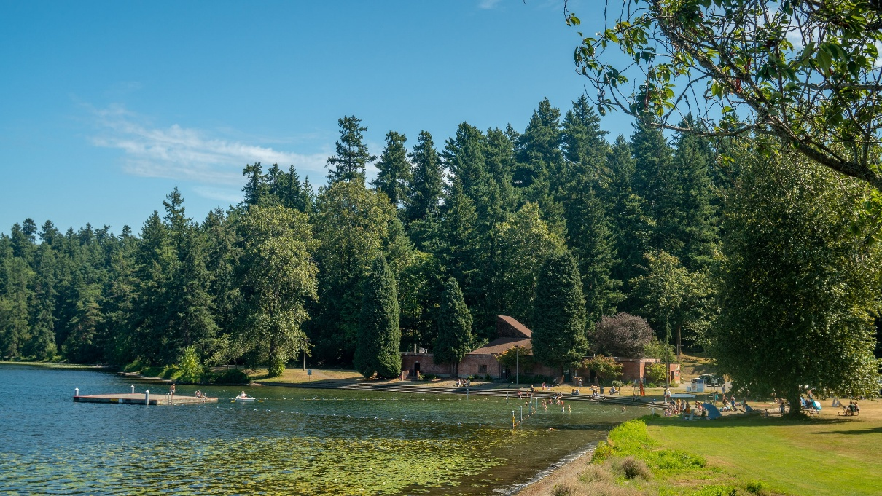
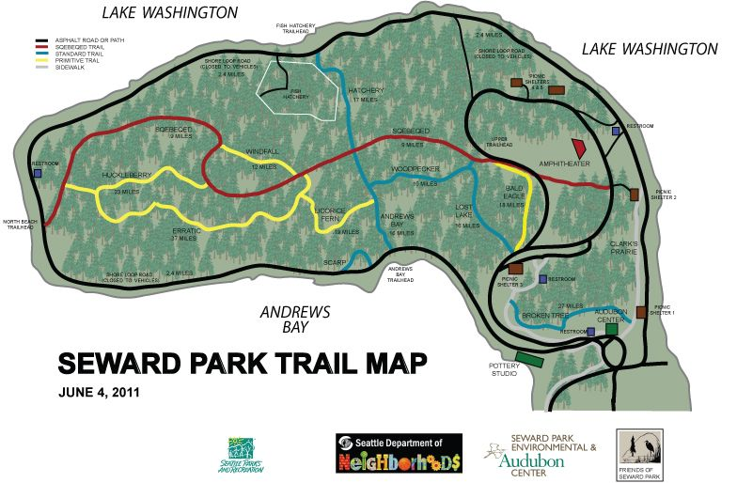
About Seward Park
Ecological gem within urban Seattle.
120 acres of Douglas fir dominated old growth forest within the 300-acre park.
Asset due to community and environmental value.
Forest is stressed with the effects of climate change, disease, invasive plants, and human misuse.
No reliable encompassing baseline vegetation data has ever been collected.

Slide 3
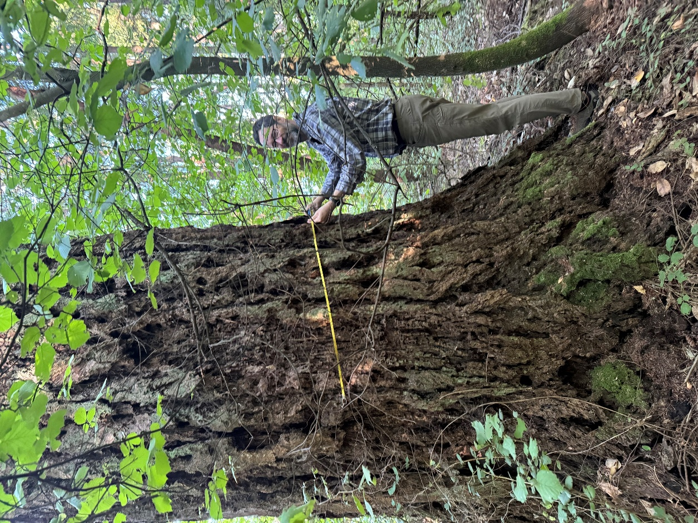
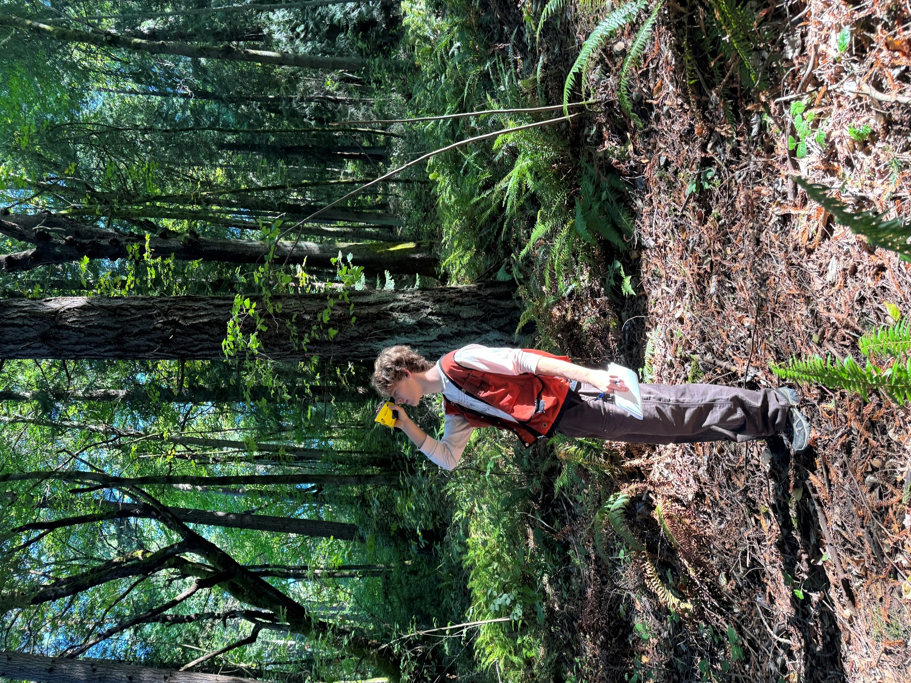
Survey Goals
To collect first comprehensive baseline vegetation data for future monitoring of Seward Park forest.
To capture forest health in summer 2024.
To replicate the study at regular intervals to identify changes within the flora of the park.
Tim and Nate hard at work!
Partnered with Friends of Seward Park as well as an experienced Seward Park Forest Steward, Paul Shannon.
Organized and conducted by Nate Butcher and Dr. Tim Billo UW.

Slide 4
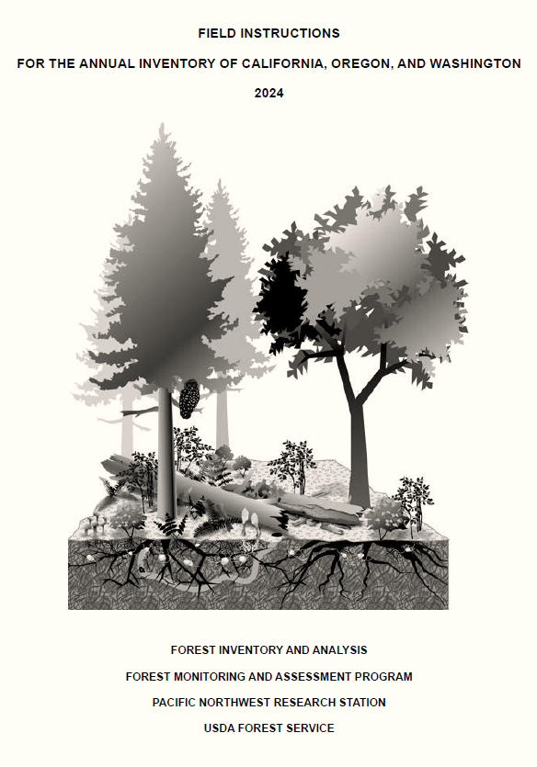
About the Protocol
Study protocol based off US Forest Service’s Forest Inventory and Analysis protocol for the PNW.
Prioritized reproducibility through precise documentation of tree locations, plot details, and walking directions for repeated data collection.
Data was tree-biased with most data tree focused
Understory vegetation and downed wood were also characterized.

Slide 5
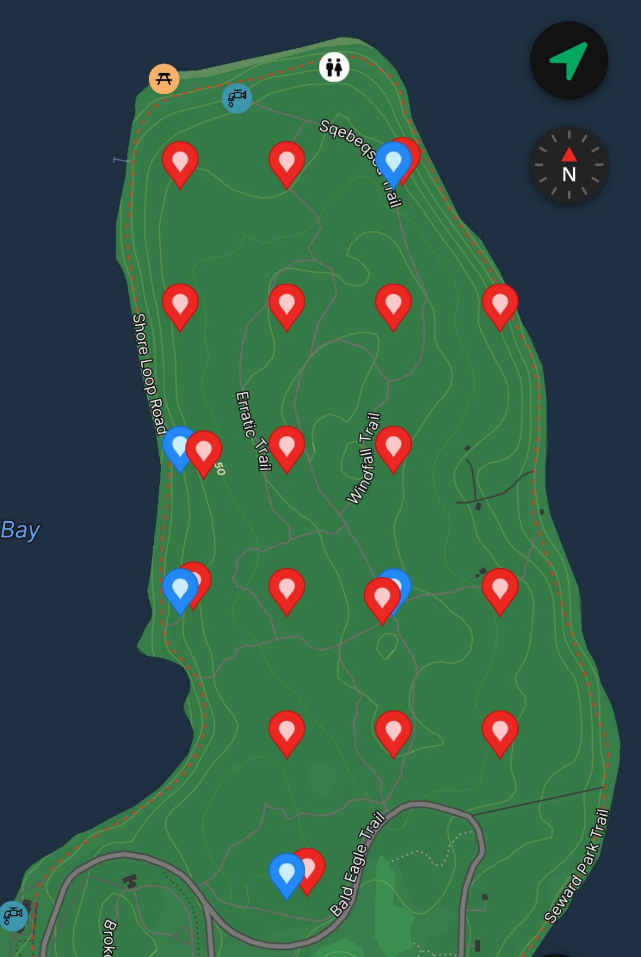
About the Plots
Red pins indicate plot location.
Blue pins marks original plot if the plot needed to be moved.
18 plots evenly distributed throughout the forest.
58.9ft radius from plot center for tree data.
24ft radius from plot center for understory vegetation data.
In cases where plots were not surveyable due to intersection by trail, they were minimally moved west or east to avoid said factor. (See Map)
Each plot center was marked by a piece of rebar.

Slide 6
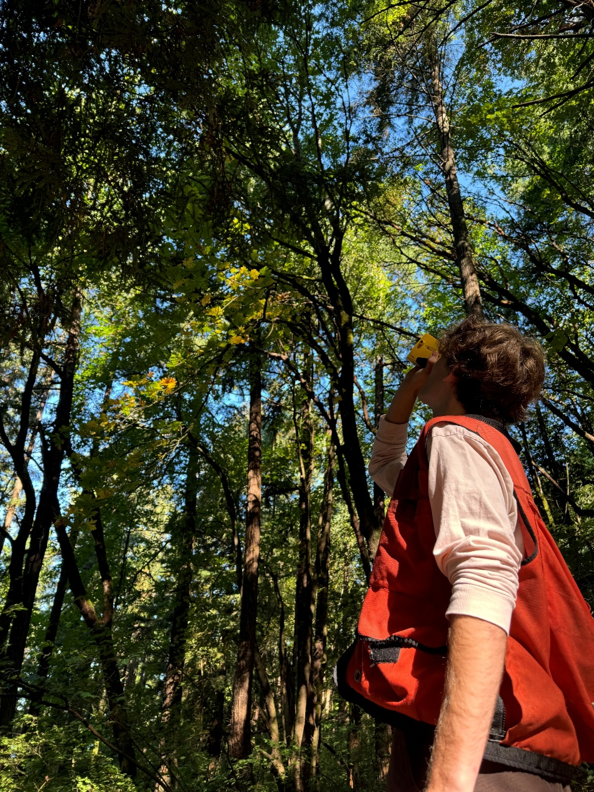
The Data
Tree Data (Stems >4.5’ tall AND >5” DBH within 58.9’ radius):
Species, Density, Height (ft), Status, DBH (in), Crown (%), Crown Class, as well as Azimuth and Distance from plot center for resurvey purposes.
Understory Vegetation Data (within 24’ radius):
Species, Percent ground coverage, Average height (ft).
Woody Stem/Sapling Data (All woody stems >2ft tall AND <5” DBH within 24’ radius):
Stem count, Species/Sapling Count, Species height (ft), Status.
Downed Wood (E/W transect through plot center):
Diameter at intersection with transect (in), Largest Diameter (in), Smallest Diameter (in), Decay class, Species.

Slide 7
Forest Composition: Basal Area by Species
Douglas-fir emerged as the most dominant species in the old-growth core, both in count and size.
This aligns with Seward Park's historical context as a Douglas-fir-dominated forest.
Basal Area by Species per Acre, in Square Feet

Slide 8
Forest Composition: Density by species (all trees >5” DBH)
Big Leaf Maple is the most common species by far, followed by Douglas Fir and Western Red Cedar.
Other Species Encountered (not in plots)
Garry Oak
Cottonwood
Chinese or European chestnut
Oregon ash
Tulip
Grand fir

Slide 9
Forest Composition: Average Tree Size by Species
Plot records by the numbers:
The tallest tree: 210-foot Douglas Fir (plot 2, SW portion of the peninsula.)
The largest DBH: 71-inch Big Leaf Maple, (six trees sharing a stem.)
Outside of the plots:
Largest DBH non-native: 76.3-inch Coastal Redwood
Largest DBH native: 69.5-inch Redcedar.
Average Tree Height and Diameter at Breast Height (DBH) by Species

Slide 10
Tree Health Status by Species
Overall, the trees in Seward Park are relatively healthy.
Western hemlock, red alder, Pacific madrone are struggling.
Note: Species with <3 in the study sample are excluded from this analysis.

Slide 11
Total Shrub Stem Count Across All Plots
All woody stems > 4.5’ tall AND <5” DBH within 24’ radius
Note: Stems found in only 1/18 plots are omitted from this chart: Himalayan blackberry, elderberry, blackcap raspberry, salal, hairy honeysuckle, dwarf rose, Pacific crabapple.

Slide 12
Sapling Count Across All Plots
Trees <5” DBH found in a 24-foot radius around the center of each quarter acre plot. Includes saplings down to 2” tall.

Slide 13
Percent Cover of Vegetation Under 4.5’ Tall
Sword fern, Trailing blackberry, Salal, and Oregon grape were the only shrubs that appeared consistently among the plots.

Slide 14
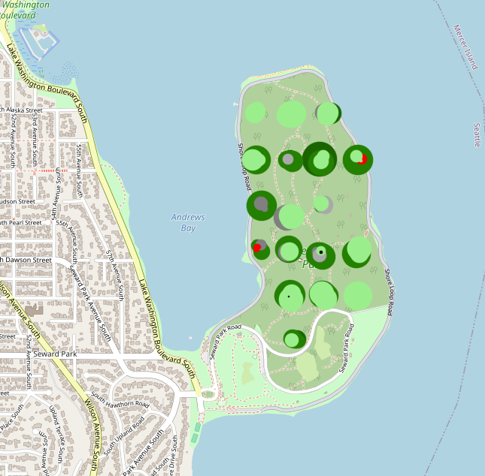
Distribution of Species
Park Steward Paul Shannon created this interactive map that visualizes each surveyed tree species, size and location.
https://paulshannon.shinyapps.io/sewardFIA/

Slide 15
Conclusions of Survey
Douglas-fir dominates in terms of wood volume
Big-leaf maple dominates in terms of density
Western redcedar has stoutest trees on average
Hazelnut and Indian plum (osoberry) highest density shrubs
Hemlock/alder/madrone are struggling, other species healthy
Small amounts of invasive species in most plots, but not dominant anywhere
Surprising encounters with non-native trees (coast redwood and Norway maple are reproducing in park, mostly around edges of forest)

Slide 16
Future Work Brainstorm (0-500 year plan)
To-Do List:
Add plots at even intervals in old-growth forest
Herbaceous layer and seedling survey
Re-survey (when?)
Incorporate into future monitoring program
Refine Protocol
Questions we can address with the data:
Relationship between canopy openness/other variables and sapling frequency (various species)
Relationship between canopy openness and stem density (various species)
Species overlap or competitive exclusion
Relationship between mountain beaver burrow presence and understory vegetation
Relationship between abiotic variables and forest health
Monitoring forest health through time (e.g., sword fern, hemlock etc.)
Seedlings and species regeneration
Fire ecology and forest development/succession
Climate change and forest succession

